Slide 1
AIRLINE CUSTOMER SATISFACTION PREDICTION
SUBMITTED BY
RESMI A
TECHOLAS TECHNOLOGIES
COCHIN

Slide 2
OBJECTIVE
This project study focuses on satisfaction level of airline customers using machine learning algorithms.
Traditional machine learning algorithms such as Decision Tree, Random Forest, Support Vector Machine, Logistic Regression have been explored.
Therefore, the study uses the application of machine learning algorithms to know the different factors that influences the customer’s satisfaction level.
The study conducts a comparative analysis on different machine learning algorithms using the Invistico Airline dataset.

Slide 3
My work
Introduce Ensemble learning models with the existing dataset and obtain 100% accuracy.
Combine of three algorithms in ML as hybrid model (Decision tree, random forest , SVM , Logistic regression)

Slide 4
Design of website
Framework : Gradio
Environment used : Jupyter notebook

Slide 5
PROCESS ON DATASET

Slide 6
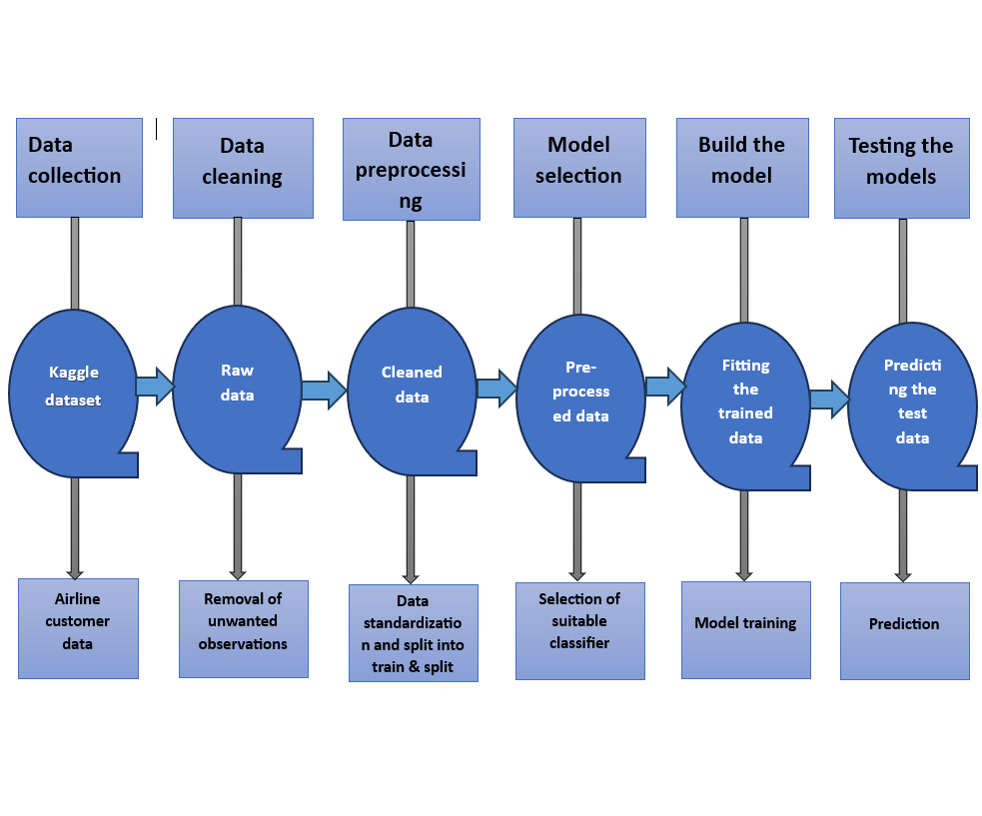

Slide 7
DATASET
Inputs : Gender ,Age ,Class ,Seat comfort, Food & drink ,Ease of online booking, On board service ,Baggage handling ,Check-in service, Cleanliness.
Output : Satisfaction

Slide 8
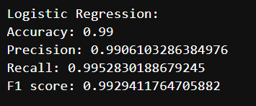
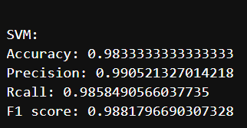
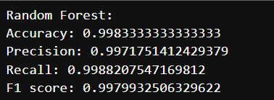
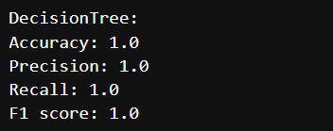
Result obtained

Slide 9
Comparison table
Datasets | Accuracy(%) | Precision(%) | Recall(%) | F1 Score(%)
Logistic Regression | 99 | 99.06 | 99.52 | 99.29
SVM | 98.33 | 99.05 | 98.58 | 98.81
Random Forest | 99.83 | 99.71 | 99.88 | 99.70
Decision Tree | 100 | 100 | 100 | 100

Slide 10
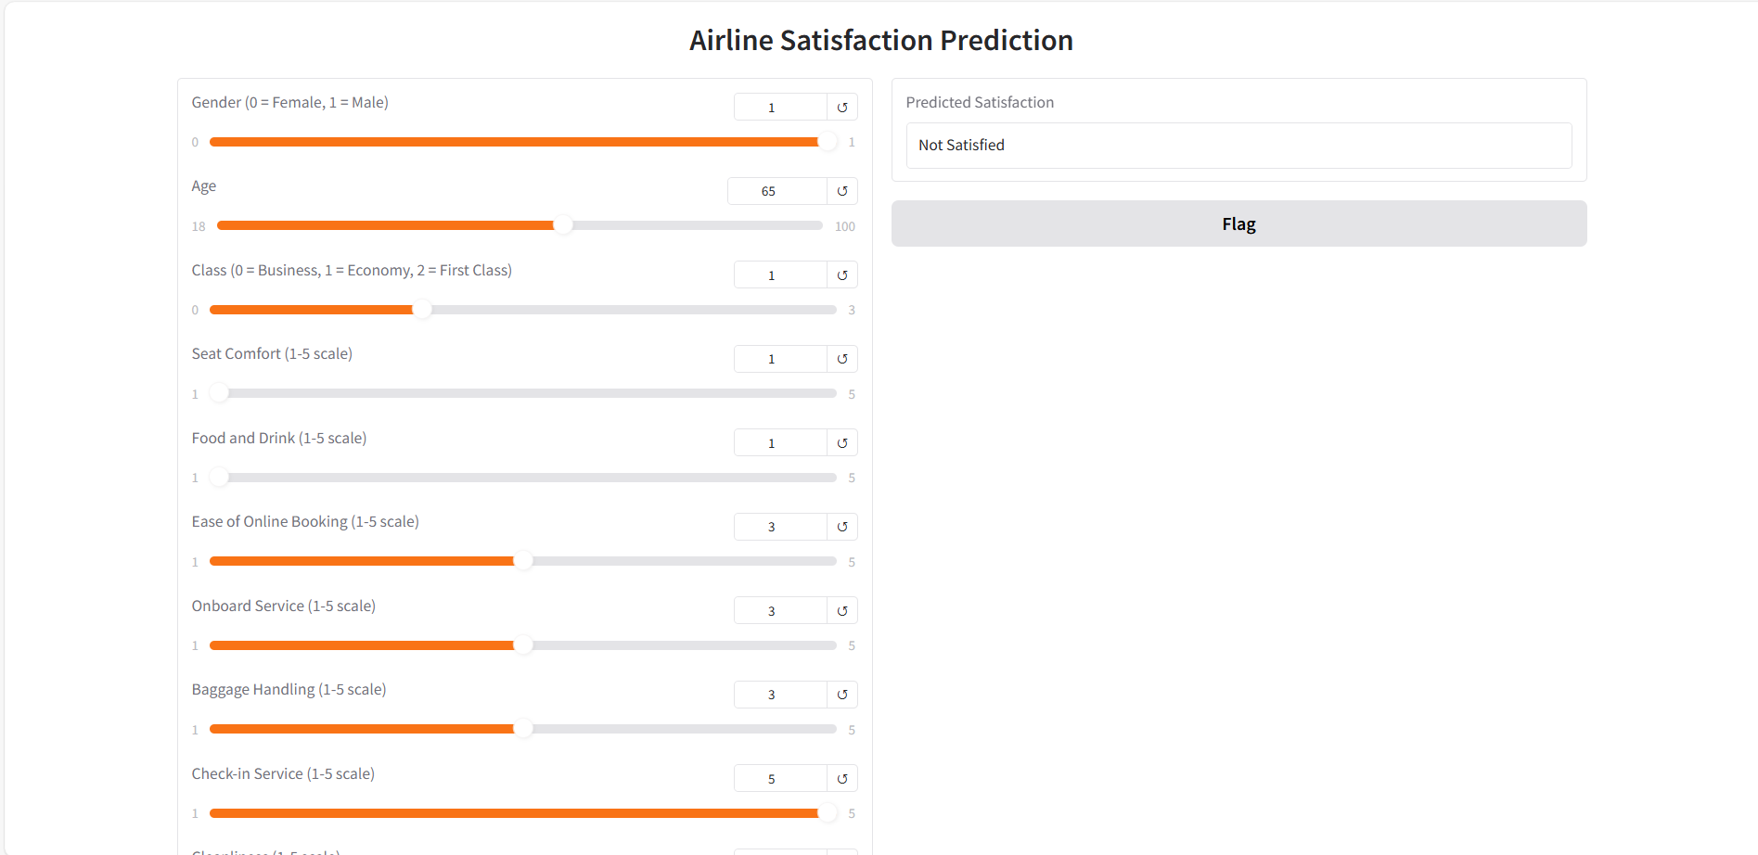
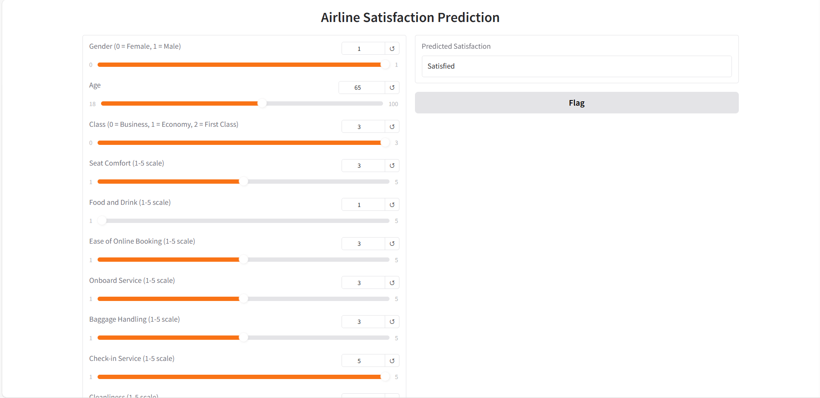
User interface

Slide 11
REFERENCE
www.kaggle.com/datasets

Slide 12
THANK YOU

